Slide 1
Big Data & Data Science

Slide 2

About Us
Recent ACHIEVEMENTS
Innovation Award winner 2017 at the Future Learning 2020 Summit
MLSL bags prestigious awards at the 3rd South Asia Education Summit 2017.
‘India’s Most Trusted Training Brand’ 2017 - Trust Research Advisory (TRA) for the 5th consecutive year
Top 20 Training Outsourcing Companies 2017 - TrainingIndustry.com for the 10th consecutive year
Most Respected Education Company 2016 – Businessworld
Top 20 Companies in Content Development 2017 - TrainingIndustry.com for the 7th consecutive year
Top 20 IT Training Company - Training Industry 2017 for the 8th consecutive year
strengths
Started training division in 1981
An alumni base of over 5.5 Million Students
Over 2.5 Lakh students join us every year
Over 22000+ placements in the last year
Over 300+ centers in India
Strategic partnerships with giants like ICICI, Microsoft, Oracle, IBM, Cisco & Tally
Pioneers in IT Training in India

Slide 3
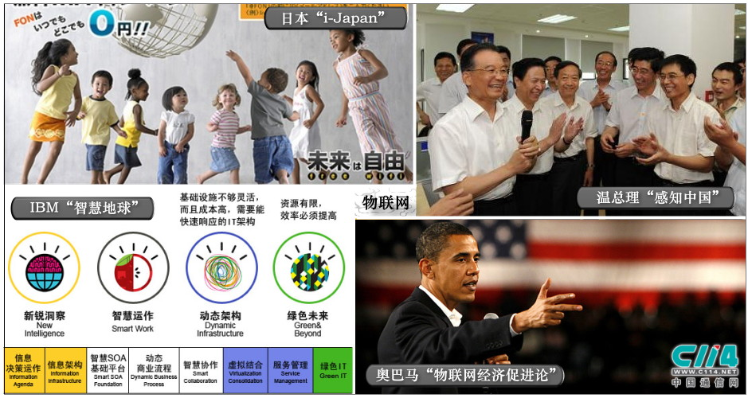
15-Year Law
1965 Main Frame
1980 PC
1995 Internet
Cloud
2025 ?

Slide 4

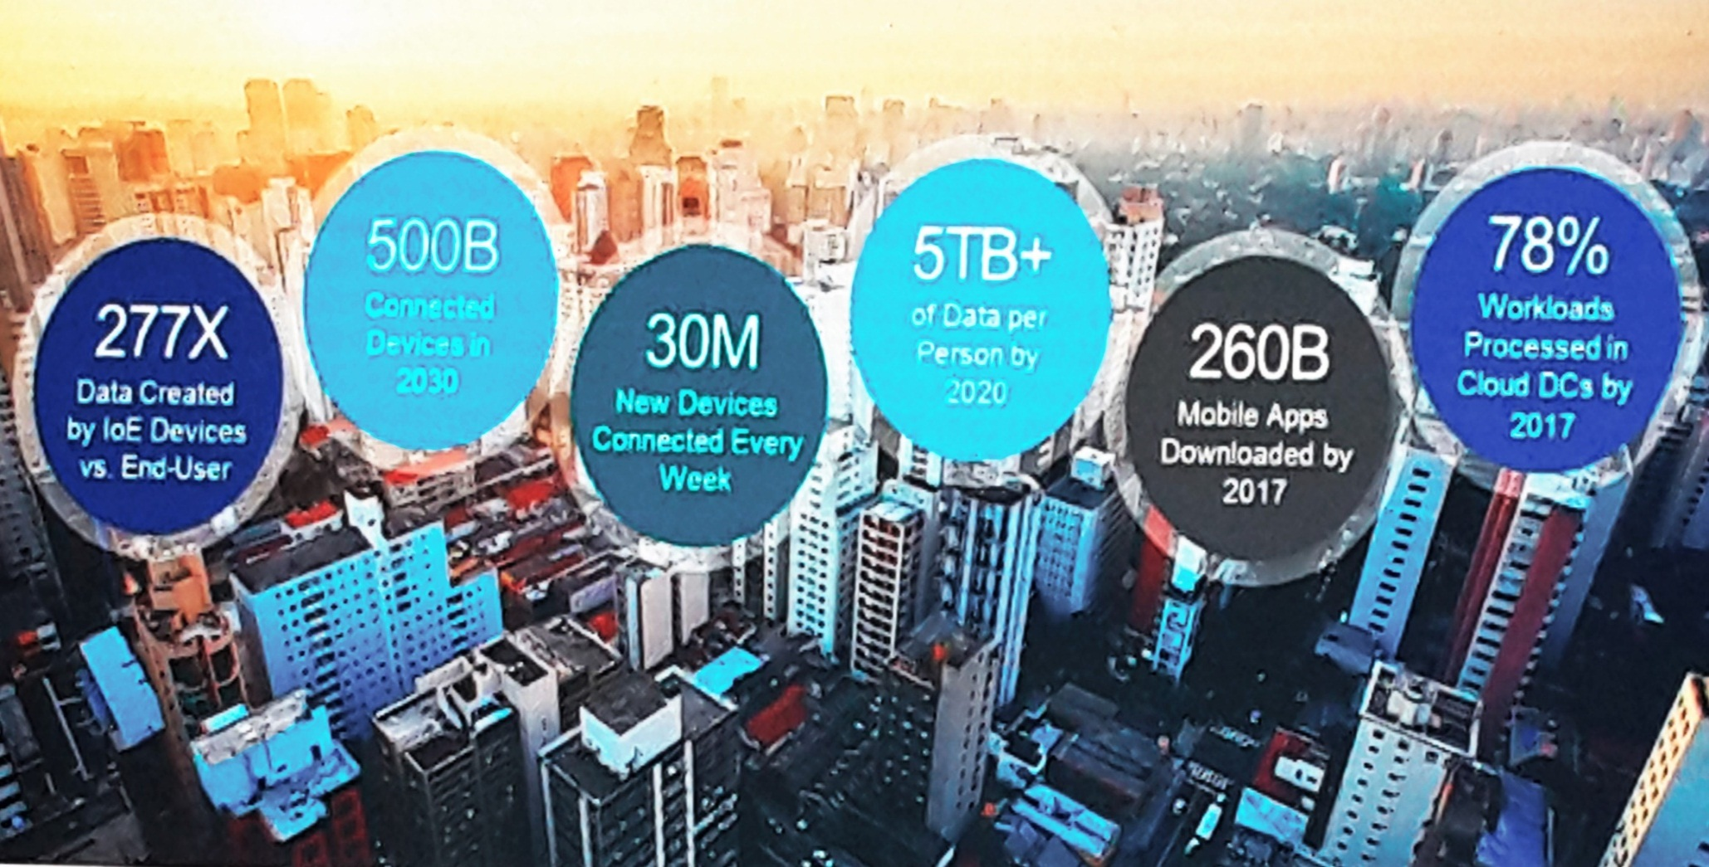
Living in Digital Age

Slide 5

The Buzz words in Digital Transformation ….
Analytics
Cloud
Mobile
Social
Internet of Things
Big Data

Slide 6





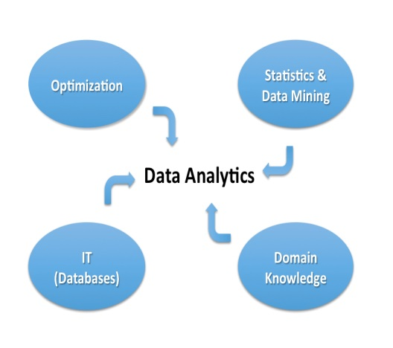
Challenges - Data Storage
Cost Effective
Security
Availability
Personalization

Slide 7
Global Business: Demand
Mobile data usage – 51% - by Dave Chaffey – EMC
78% data is accessed in cloud by 2017 - IDC
Responsive software Design
Digital materials and video streaming support
Quick accessing
Industry approach – 1.5 M business in IoT by next year

Slide 8
Big Data Analysis

Slide 9
What is Big data?

Slide 10
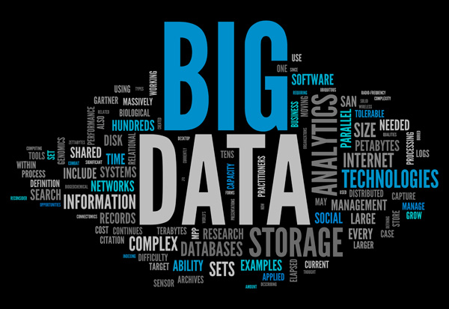

Slide 11
Big Data
Big Data is similarly a data but bigger in size. Its generates value from the storage and processing of very large quantities of digital information that cannot be analyzed with traditional computing techniques.

Slide 12
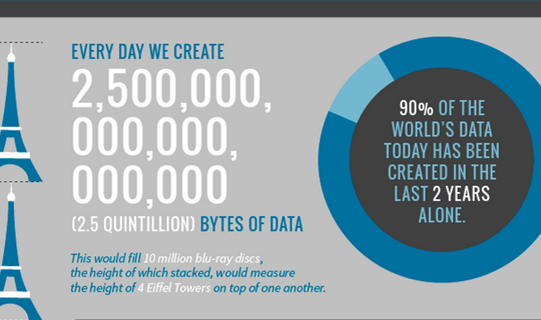

Slide 13

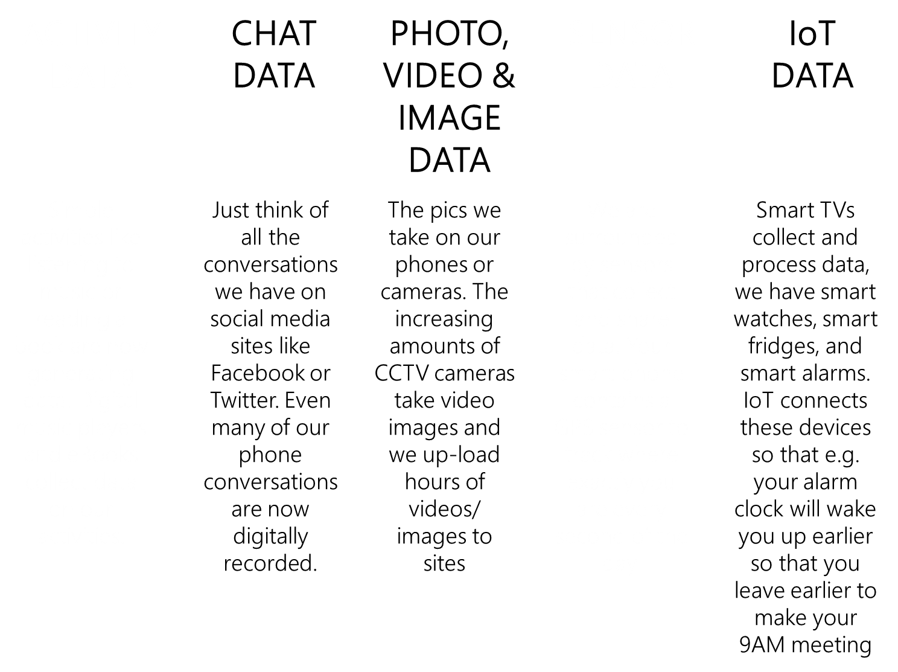

Slide 14
Session Flow
Types of Data in Digital World
Hadoop
Python
Cloud
Front End designing

Slide 15
DATA
Structured DATA
Will have Row & Column .
Highly organized
Used by Database management systems
Unstructured Data
No standard format.
Commonly used in all sensor data transformation
Audio ,text , digital format

Slide 16
Growth of unstructured Data – in Past 10 years

Slide 17
Common Unstructured Data Format
1. Comma Separated Values(CSV)
Generally used to transfer data between applications.
Eg. Convert Database into Excel
2 JavaScript Object Notation (JSON )
Readable by man as well as machine
Used for data interchange.
supports all datatypes and arrays
3 Binary JSON (BSON)
BSON is extended version of JSON,
Uses for data encode and decode in various languages
4 XML (eXtensible Markup Language)
Markup language , supports Convergence

Slide 18
NoSQL (Not Only SQL)
Types
key-value
Column Oriented
Document Oriented
Graphs stores
Object Oriented Data store
Advantages
Access any strucuted & Unstructured Data
Faster
Lower investment
Flexible
Scalable

Slide 20
NoSQL - MongoDB
MongoDB – one of the best open source database
MongoDB data can be divided units to support Hadoop also
Effective model : MongoDB in hybrid cloud
Why Mongodb
Sharding
Advanced Text Searching
Map Reduce
Support of Unstructured Data

Slide 21
FACEBOOK - MongoDB

Slide 22
Hadoop
Apache Hadoop is an open source framework for running applications on large cluster. Works under master-slave.
A common way of avoiding data loss is through replication. Redundant copies of the data are kept by the system so that we can have another copy of data.
The next problem is solved by a simple programming model called “MapReduce”. It is a powerful technology designed for deep analysis and transformation of huge data sets.

Slide 23
Features of Hadoop
Low cost
Scalability
Fault tolerant
Efficient
Fast

Slide 24
Major Components
HDFS
Its capable of storing data across thousands of commodity servers to achieve high bandwidth between nodes
Map Reduce
Its provide the programming models used to tackle large distributed data processing (mapping data and reducing it to a result).

Slide 25
Hadoop Eco System s
There are various tools in hadoop eco systems
Pig
Hive
Sqoop
Flume
Hbase
Zookeeper
Oozie

Slide 26
Technology used
Map Reduce / Advance Map Reduce
Pig
Hive
Sqoop

Slide 27
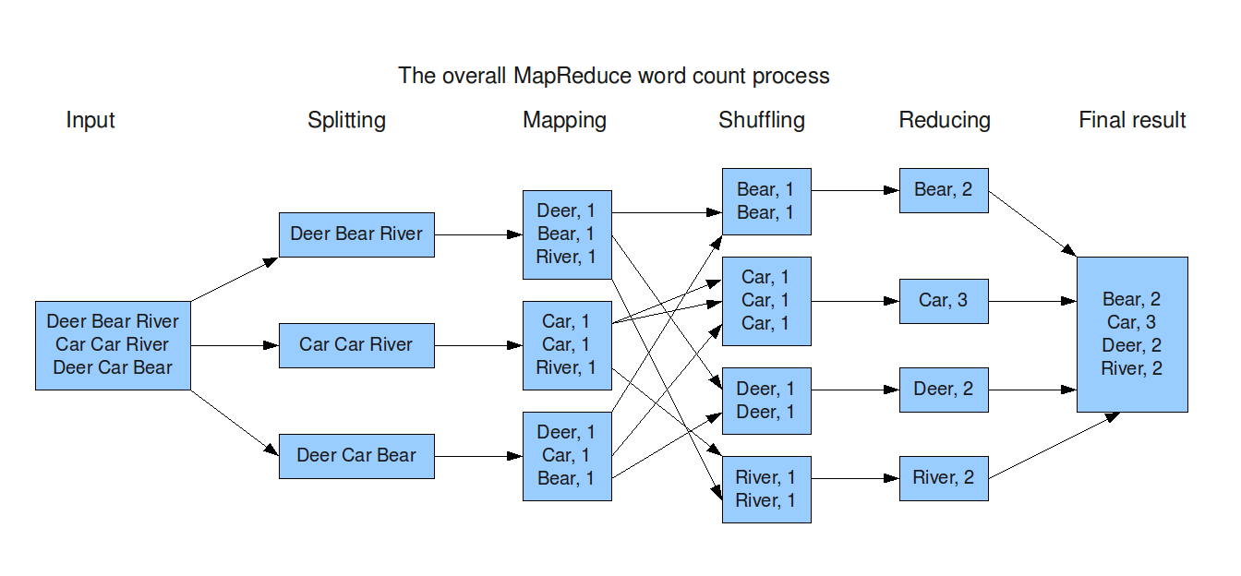
Map Reduce

Slide 28
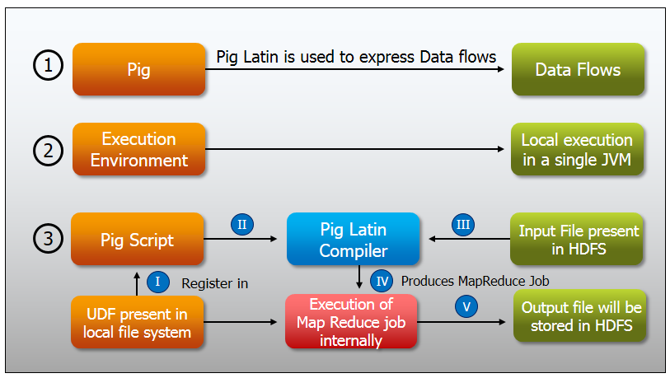
Pig

Slide 29
Example
step1 = load '/user/cloudera/Census_Records.json' using JsonLoader('Age:int,Education:chararray,Marital:chararray,Gender:chararray,Tax:chararray,Income:float,Parent:chararray,Birth:chararray,Citizen:chararray,Work:chararray');
step2 = foreach step1 generate $1 as Edu,$3 as Gen;
step3 = group step2 by ($0,$1);
step4 = foreach step3 generate group,COUNT(step2.Gen);
dump step4;

Slide 30
Hive
Hive gives an SQL-like interface to query data stored in various databases and file systems that integrate with Hadoop. The traditional SQL queries must be implemented in the Map Reduce Java API to execute SQL applications and queries over a distributed data.

Slide 31
Example
set year = 2016;
select count(*) as voters from census where age+(${hiveconf:year}-YEAR(from_unixtime(unix_timestamp())))>=18;

Slide 32
Sqoop
Sqoop (SQL-to-Hadoop) is a database import tool which provides the capability to easily copy tables or entire databases between SQL databases(RDBMS) and Hadoop files in HDFS (Hadoop Distributed File System).

Slide 33
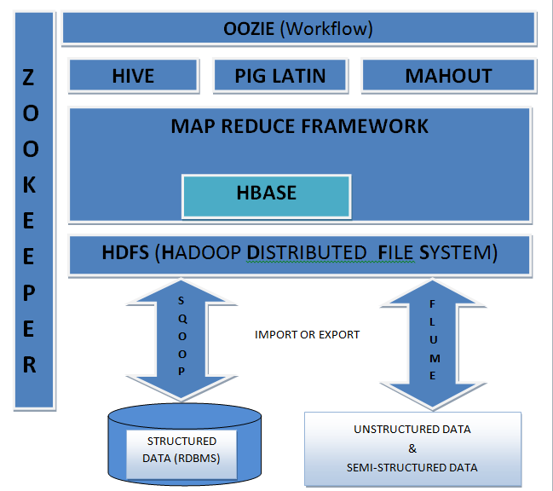
How its work?

Slide 34
PYTHON & Big Data
NIIT

Slide 35

Python is powerful and fast…; plays well with others; runs everywhere; is friendly & easy to learn; and is Open.

Slide 36
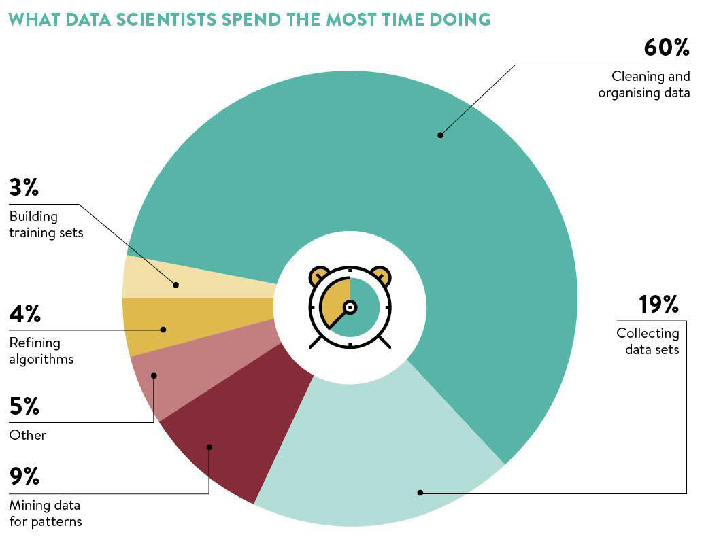

Slide 37
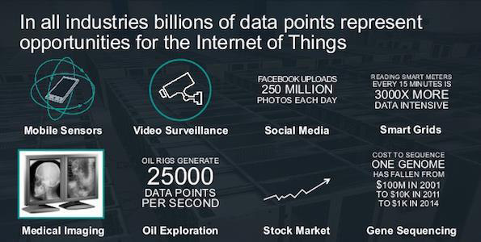
Data Science in Industry

Slide 38
PYTHON & Big Data
Python is very a popular option for big data processing due to its simple usage and wide set of data processing libraries.
Making scalable applications.
To integrate easily with web applications.

Slide 39

Web Scraping – Surfing Net
Web Scraping is a technique to retrieve data based on patterns from pages.
All type of search engine use the concept of Web Scraping and we also call it Web Spidering or Web Crawling.
As per the preceding concept there are different techniques of parsing the HTML Page in Python.
Using Regular Expression
Using BeautifulSoup
Notes:
Parsing HTML :- One of the common uses of the urllib capability in Python is to scrape the web. Web scraping is when we write a program that pretends to be a web browser and retrieves pages and then examines the data in those pages looking for patterns.
For Example when we use Google search it looks at the source of page and extracts the link to other pages and retrieves those pages. This process keeps on going till user gets the desired page. Using this technique, Google Spiders its way through nearly all of the pages on the web. Google also uses the frequency of links from pages it finds, to a particular page as one measure of how “important” a page is and how highly the page should appear in its search results.
Advantage of Web Scraping:-
It helps to pull the data from the Web Site.
It also helps to monitor the site for new data update.
It helps in creating database for search engine related Web Sites.
Note :- Every Web Site owner does not like the concept of Web Scraping.

Slide 40
Visualizing Mail Data
Sometimes you have to pull down mail data from servers and that might take quite some time and the data might be inconsistent, error filled and need a lot of clean up or adjustment.
We work with an application that is the most complex and pull down nearly a gigabyte of data and visualize it.
Notes:
Let’s discuss another project about Visualizing mail data from servers and data is most complex so far and pull down nearly a gigabyte of data and visualize it.
In this project we have 7 files –
gmane.py - operates as a responsible caching spider in that it runs slowly and retrieves one mail message per second so as to avoid getting throttled by gmane. It stores all of its data in a database and can be interrupted and re-started as often as needed. It may take many hours to pull all the data down. So User may need to restart several times.
gmodel.py - reads the rough/raw data from content.sqlite and produces a cleaned-up and well-modeled version of the data in the file index.sqlite. The file index.sqlite will be much smaller (often 10X smaller) than content.sqlite because it also compresses the header and body text.
gbasic.py - simplest data analysis is to determine ”who sent the most mail?” and ”which organization sent the most mail”?
gword.py - produces a simple visualization of the word frequency in the subject lines.
gline.py - computes e-mail participation by organizations over time.
The output of this project output is written to gline.js which is visualized using gline.htm.

Slide 41
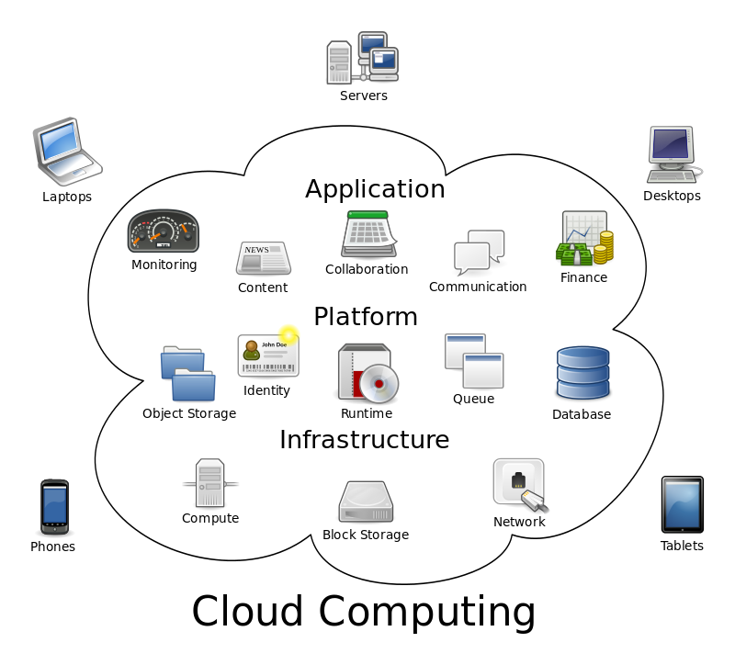
Cloud computing

Slide 42
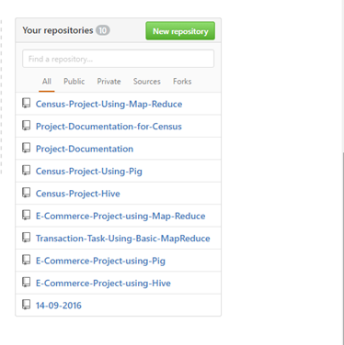
Github

Slide 43



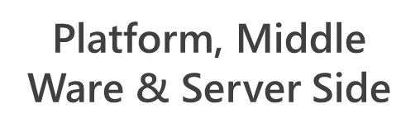
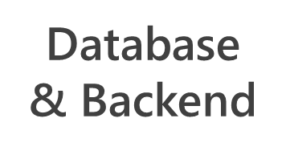










NO SQL

Slide 44


Slide 45
QUERIES?

Slide 46
THANK YOU

